Slide 1
An introduction to Invasive Non-Native (Alien) Species

Slide 2
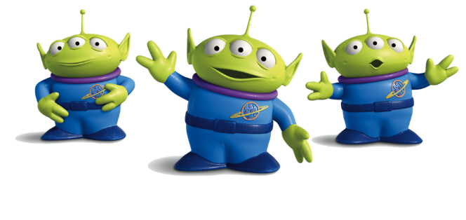
Help! Our local wildlife is under threat from Alien invaders!
We need you to become Alien Detectives…..
Could you learn about alien species, what they are, where they come from and what they are doing here?
Great! Then you can help us tackle the aliens, spread the word and help protect our environment.

Slide 3
What is an “Alien” or “Non-native” Species?
Alien, non-native and introduced can all mean the same thing…
A non-native or alien species is a plant or animal that has been transported outside of its natural home range by humans - either accidentally or intentionally.
A native species is one that has always grown or lived in a place (since the last Ice Age).
Over 2,000 non-native (alien) species have been introduced into Britain from all over the world.
Notes:
Invasive Non-Native Species - An invasive non-native species is any animal or plant that is outside of its natural range that has the ability to spread causing damage to the environment, the economy, our health and the way we live.

Slide 4
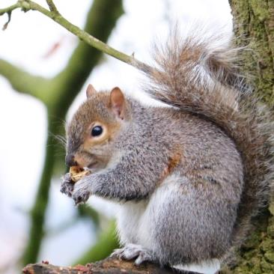
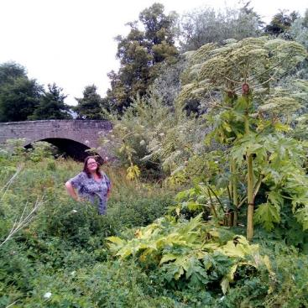
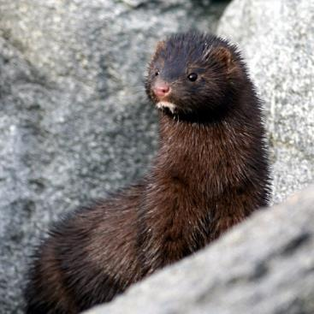
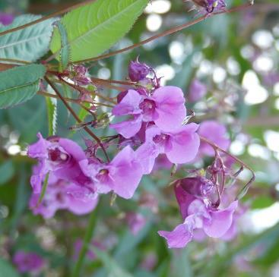
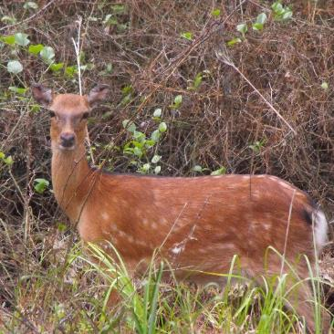
Examples of non-native, alien species
Can you name any alien species present in Scotland?
Grey squirrel
Giant hogweed
American mink
Himalayan balsam
Sika deer
These are just a few – there are lots more!
Notes:
Animals: Grey Squirrel, American Signal Crayfish, American Mink, Domestic Cats & Dogs, Zebra Mussel, Sika deer,
Plants: Japanese Knotweed, Giant Hogweed, American Skunk Cabbage, Himalayan Balsam, White Butterbur, Sitka spruce, Giant rhubarb (Gunnera),

Slide 5
Invasive species
What do you think an invasive species is?
The term invasive is reserved for the most aggressive species capable of damaging the environment when and where they establish.
Invasive species cause severe problems - they may cause harm or damage to;
our wildlife and our environment
our health or the way we live
our economy (they cost us lots of money)
Invasive species can be either native or non-native, most of the ones that cause serious problems are non-native.
Notes:
Note that “invasive” can apply to native species as well as non-native - but this is rare occurance. E.g. Bracken is a native species, but is invasive.

Slide 6
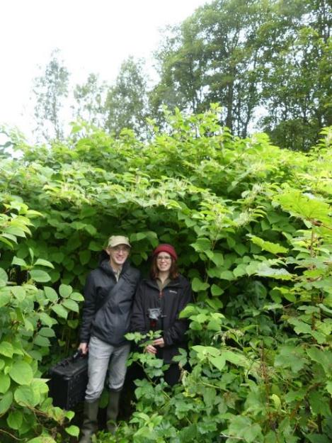
Invasive non-native species (INNS)
Invasive, non-native (alien) species are the most successful species in their new locations and those that cause the most severe problems.
They are often bigger, faster growing or more aggressive than our native species and may have no natural predators to control their numbers or limit their spread.
As a result, native species are often unable to compete with these alien invaders and so decline.
Notes:
This is the term we use a lot; Invasive Non-Native Species - also referred to by its acronym “INNS”.
In Europe the term Invasive Alien Species is more commonly used (IAS), but in GB “Non-native” is generally used more often than “Alien”.

Slide 7
How do the aliens get here?
All invasive non-native species were introduced into Britain by people - either accidently or on purpose. How do you think this happens?
Travel and Trade
Ornamental Plants
Hitchhikers that get a lift on a boat hull, in or on cargo, in deliveries or tourist luggage.
Plants brought back by Victorian plant hunters for gardens - which later spread into the wild.
Ornamental Animals and Pets
Commercial use; Food and Fur
Animals brought back to keep in estate parks and zoos or as pets - which later escape or are deliberately released.
Animals or plants brought here because they were useful.
Notes:
Examples of introduction pathways – Victorian Plant Hunters & Garden Escapees, Fur Farming (Mink), Food Industry (American Signal Crayfish), Pets (goldfish, parakeets), Hitchhikers on migratory animals, in ships ballast tanks etc (Shellfish, oysters, aquatic invertebrates), Global Warming (migration of species from further south – beech tree etc)

Slide 8
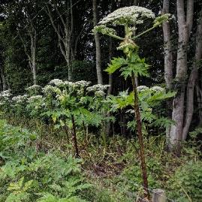
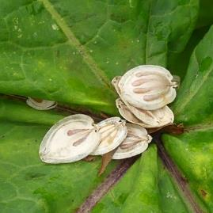
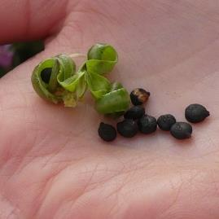
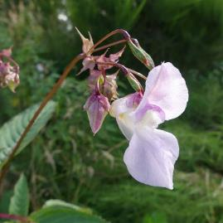
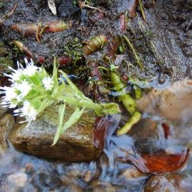
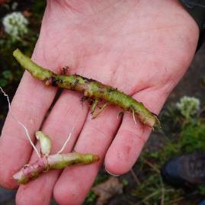
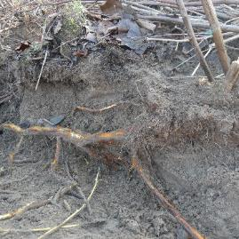
How are the aliens taking over?
Some plants produce huge numbers of seeds
These can float, fly and stick
How do you think they get spread?
Some plants have rhizomes (roots)
A tiny bit of rhizome can grown into a new plant!
Notes:
Comparisons can be made to native seed dispersal, except we want to stop the spread of these seeds!

Slide 9
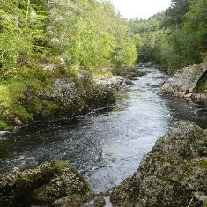
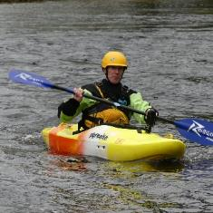
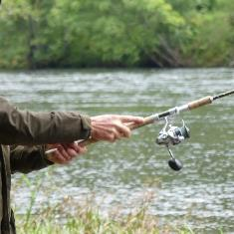
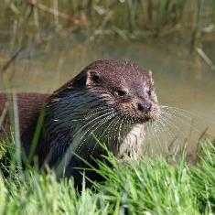
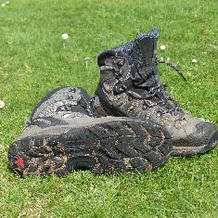
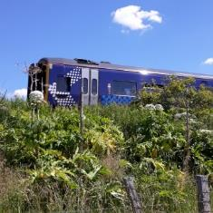
How are the aliens taking over?
Drop into water and float downstream, or blow in the wind.
Seeds
Plant fragments Rhizome fragments
Attach to fishing gear, boats, waders and wellies.
Get caught in animal fur or on their paws.
Attach to shoe treads and bike tyres or to cars and trains.
Notes:
Rivers, Railways, Paths and Roads are main distribution corridors
Plants – seeds or root fragments into water, in shoe treads, bike treads, animal fur/feet, dragged by cars/trains
Animals (and eggs etc) – swim/walk (mink move up to 100km from birth), fishing nets, canoes, boats etc

Slide 10
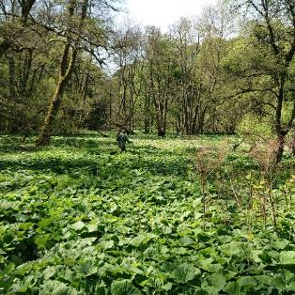
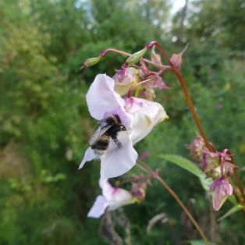
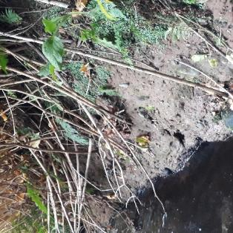
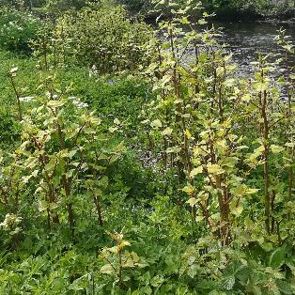
What impacts are the aliens having?
Can you think of any problems that invasive non-native plants can cause for our wildlife and to the environment?
Invasive plants out-compete native flowers. They grow fast and take over, shading out native plants.
Invasive plants have big, showy, flowers which attract pollinators away from native flowers.
Invasive plants have weak root systems which leads to bank erosion and a risk of flooding.
Invasive plants change the habitat of the riverbank which affects the insects and animals that live there.
Notes:
See if the group can guess any problems before you reveal the answers

Slide 11
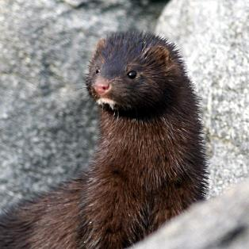
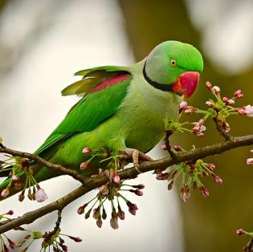
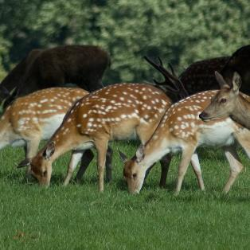
What impacts are the aliens having?
Can you think of any problems that invasive non-native animals can cause for our wildlife and to the environment?
Predation. American mink prey on water voles and ground nesting birds, devastating their populations.
Competition. Ring-necked parakeets compete with native birds for nest sites and for food.
Carry disease. Grey squirrels carry a virus which though it doesn’t affect them is deadly to our native red squirrels.
Hybridisation. Sika deer interbreed with native Red deer, causing a hybrid deer.
Notes:
See if the group can guess any problems before you reveal the answers

Slide 12
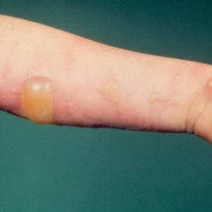
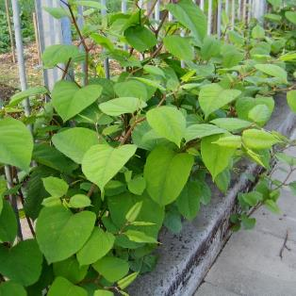
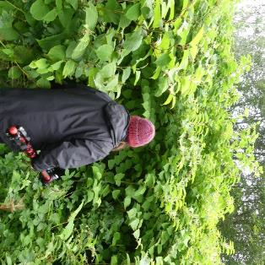
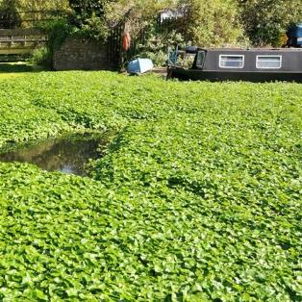
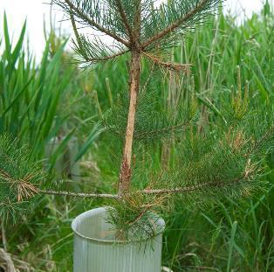
What impacts are the aliens having?
Invasive non-native species can also cause problems to our well-being and our way of life. Can you think of any ways they impact on us?
The sap of Giant hogweed causes severe skin burns and blisters.
Japanese knotweed can grow through cracks and damage property - costing a lot of money to remove.
Invasive plants can grow very large and can block footpaths for walking and access to rivers for fishing.
Invasive water plants block rivers and canals and prevent boats sailing on them.
Rabbits and deer cause damage to trees and agricultural crops.
Notes:
See if the group can guess any problems before you reveal the answers.
Worth stressing the issue of Giant hogweed sap and the danger it poses.

Slide 13
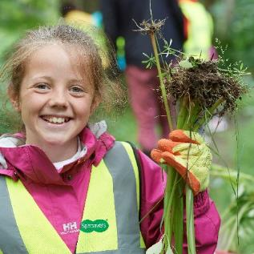
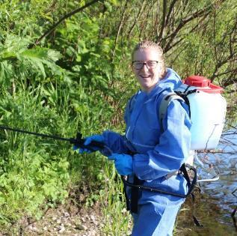
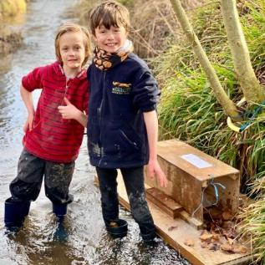
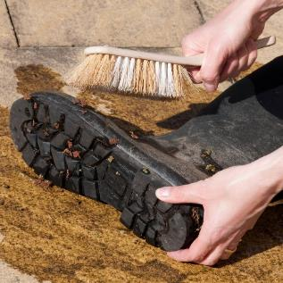
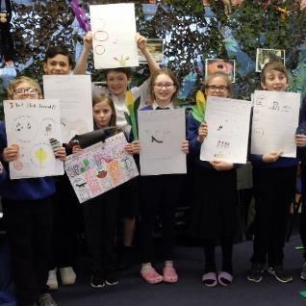
Can we stop the aliens?
Yes! And as an alien detective you can help. What do you think we can do to rid Scotland of these alien invaders?
We can remove invasive plants. Some can be pulled up, dug out or cut down.
Some invasive plants need to be sprayed with pesticide.
We can monitor for and trap invasive animals e.g. American mink and Grey squirrel.
We can practise good Biosecurity by cleaning our boots and gear when we’ve been out.
We can spread the word and tell other people about the problem and how they can help too.
Notes:
See if the group can guess any problems before you reveal the answers.

Slide 14
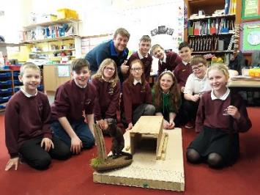
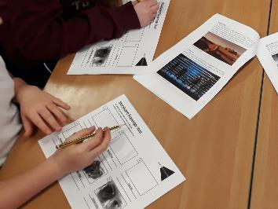
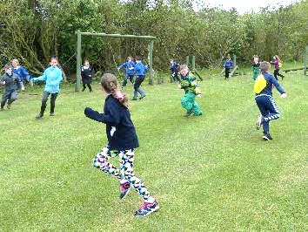
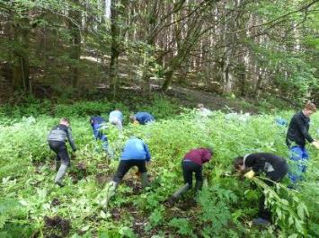
What next?
Find out more!
Over on our website you’ll find lots of activities, worksheets and games to help you discover more about some of the things mentioned in this introduction.
www.invasivespecies.scot/alien-detectives
Discover more about aliens and the alien invasion.
Worksheets and activities to do in the classroom.
Games to play both indoors and outside.
Practical activities about aliens and exploring the river.
Notes:
Don’t forget – there is also a certificate that you can award when your group has completed a few activities. Download from our website.

