Slide 1
Native or Not?

Slide 2
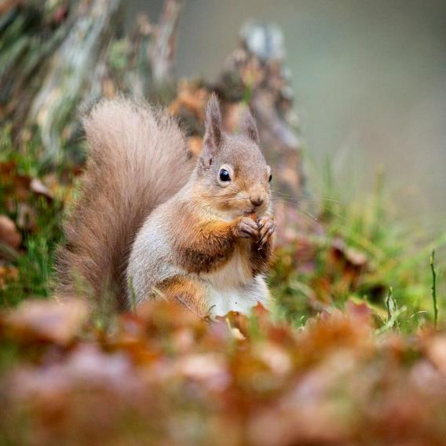
Red squirrel
Native

Slide 3
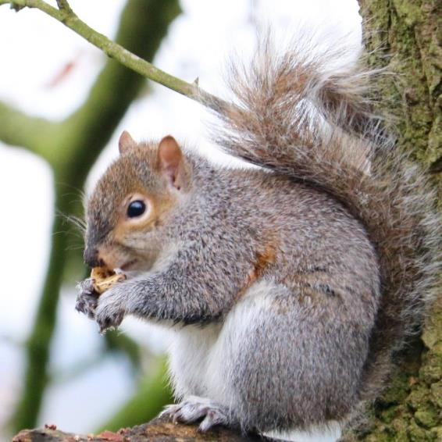
Grey squirrel
NoN - Native
Introduced from America in 1828.
Competes with our native red squirrels for food and carries a disease which is deadly to red squirrels.

Slide 4
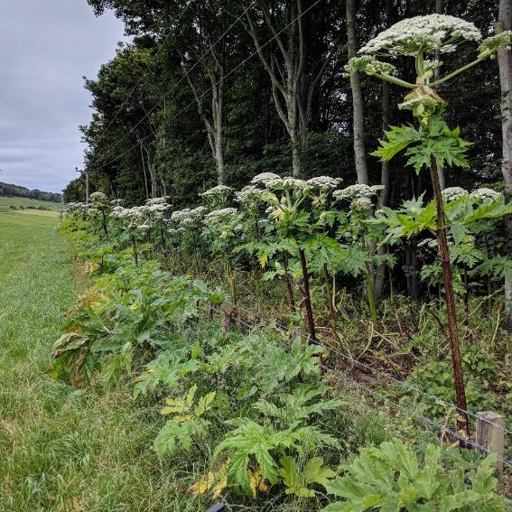
Giant hogweed
NoN - Native
First recorded growing in the wild in 1828.
! Don’t touch, contains a toxic sap that causes skin burns.

Slide 5
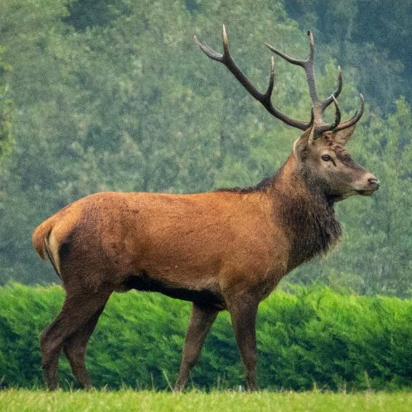
Red deer
Native

Slide 6
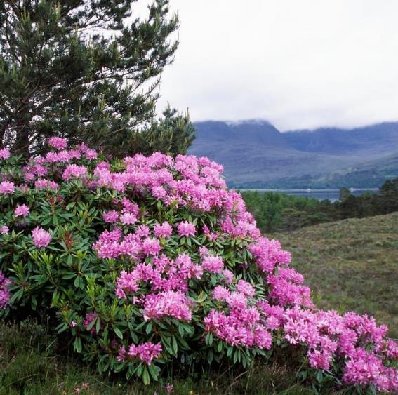
Rhododendron
NoN - Native
Has been spreading widely through woodlands and stopping native flowers growing since 1894.

Slide 7
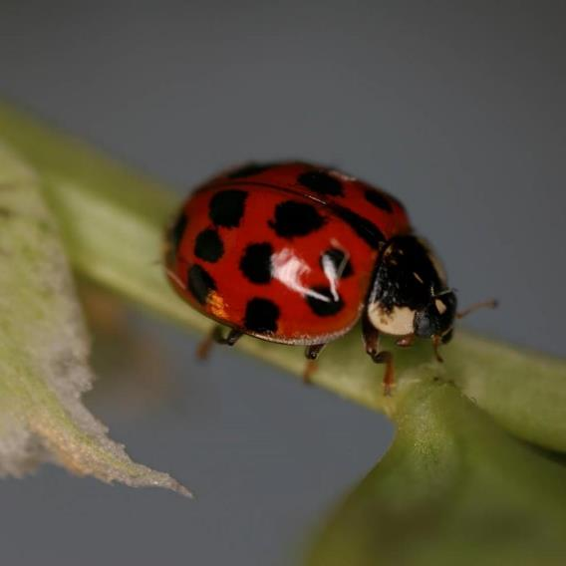
Harlequin ladybird
NoN - Native
Another recent non-native to arrive in Great Britain, it is has been here since 2004.
© Mike Majerus

Slide 8
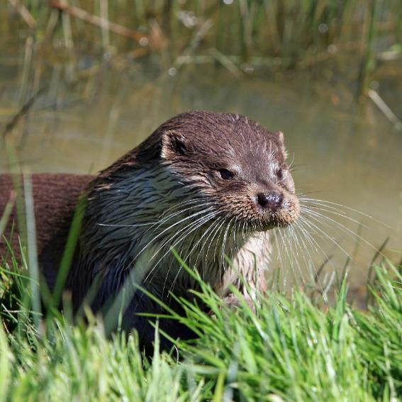
Otter
Native

Slide 9
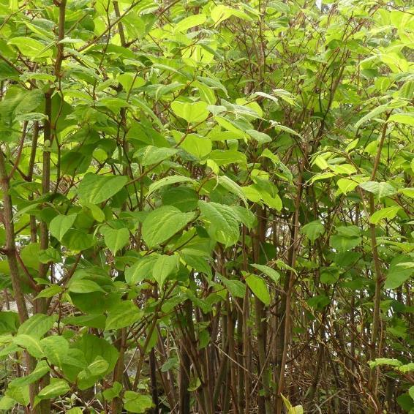
Japanese knotweed
NoN - Native
Introduced from Japan and has been growing wild since 1886.
It is really difficult to get rid of, can grow through cracks in walls and is a serious pest for the building industry.

Slide 10
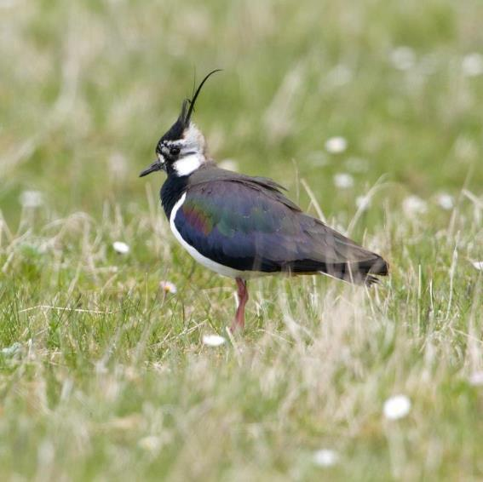
Lapwing
Native

Slide 11
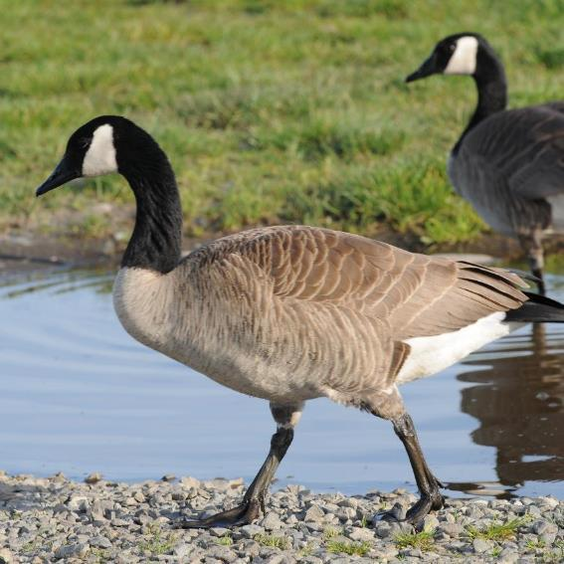
Canada goose
NoN - Native
Canada geese have been around a long time in the countryside – since 1731.
They were first introduced into St. James Park in London.

Slide 12
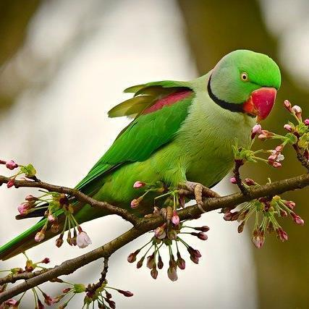
Ring-necked parakeet
NoN - Native
This exotic looking bird has been living wild in Great Britain since 1855.
It competes with native birds for food and nesting sites.

Slide 13
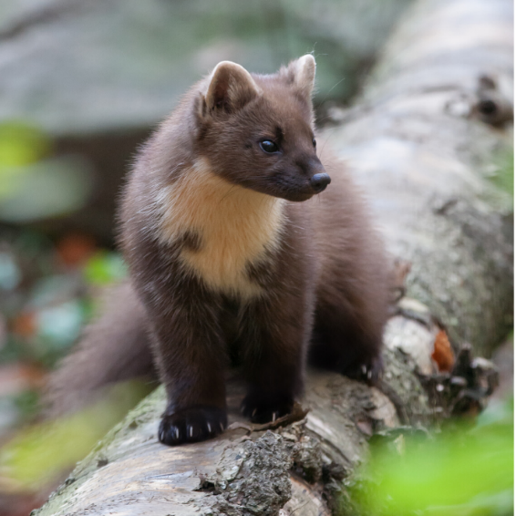
Pine marten
Native

Slide 14
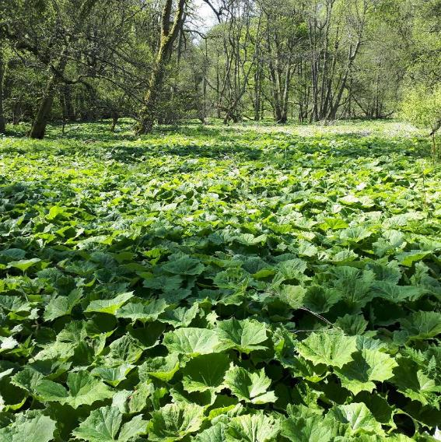
White butterbur
NoN - Native
Growing wild since 1843.
Has big leaves which form a dense carpet on the ground and completely shade out all native plants underneath.

Slide 15
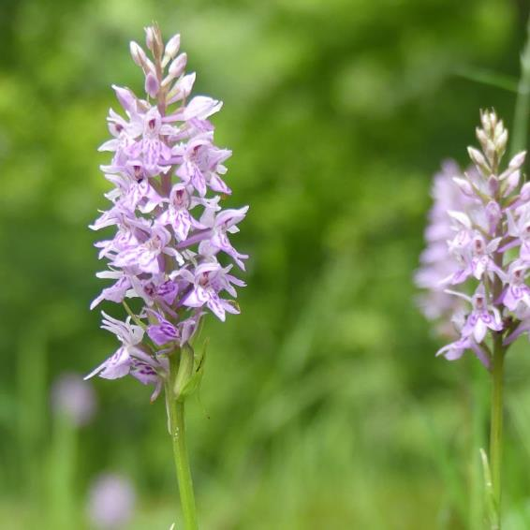
Heath spotted orchid
Native

Slide 16
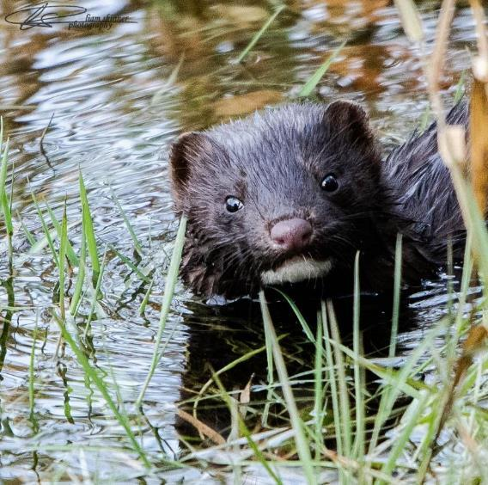
American mink
NoN - Native
Originally from America, it was brought over and kept in fur farms - but escaped and has been living wild since 1948.
Predates on ground nesting birds and small mammals like the water vole.

Slide 17
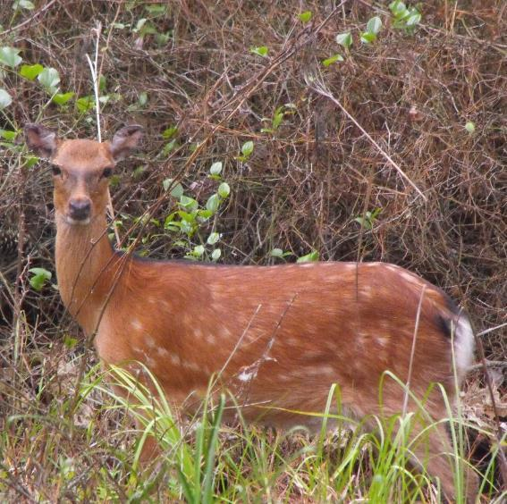
Sika deer
NoN - Native
Found throughout the countryside since 1874.
At first glance they look quite similar to our native red deer, but have white spots on coat and black marks on tail.

Slide 18
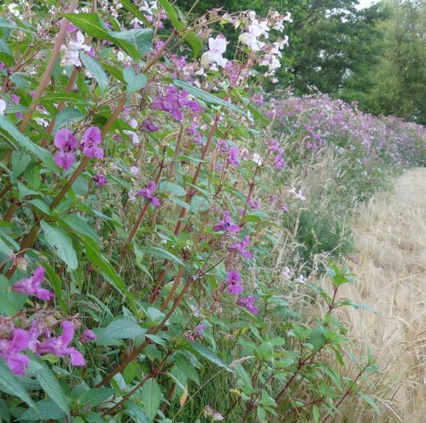
Himalayan balsam
NoN - Native
Has been growing in our countryside since 1855.
Out-competes native flowers and takes over on riverbanks.

Slide 19
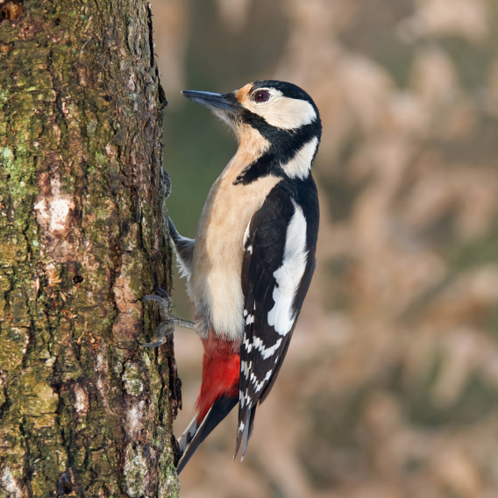
Great spotted woodpecker
Native

Slide 20
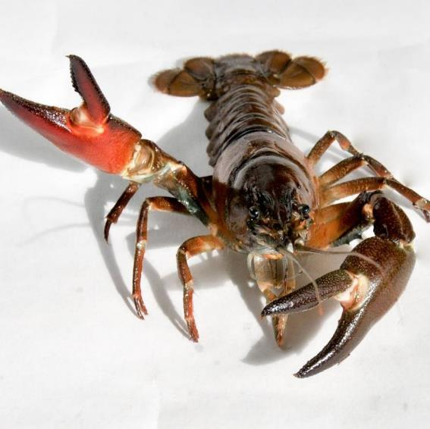
Signal crayfish
NoN - Native
Brought from North America – sometimes with a plan to farm for food – but were released and escaped into our rivers in 1975.
Competes with native crayfish for food and predates on native river life. Can carry crayfish plague which kills native crayfish.

Slide 21
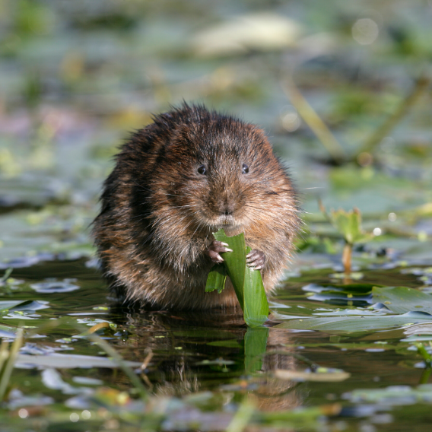
Water vole
Native

Slide 22
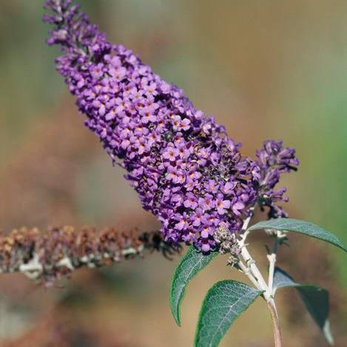
Buddleia
NoN - Native
Originally from China, it has been growing wild since 1922.
Also known as the “butterfly bush” as is popular with insects and butterflies.

Slide 23
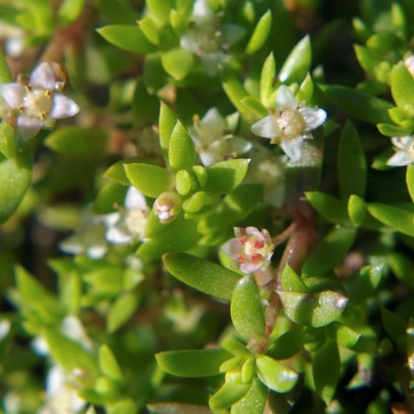
New Zealand pigmyweed
NoN - Native
Found growing wild in the countryside in 1956.
It is a water weed and was sold to put into garden ponds.
© CC Ashley Basil

Slide 24
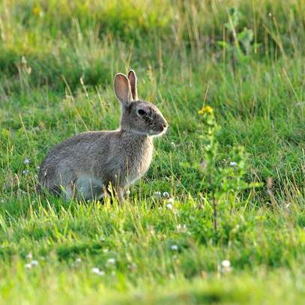
Rabbit
NoN - Native
The rabbit is probably the non-native species that has been around the longest – since 1176.
Some consider rabbits to be naturalised as they have been part of our wildlife for so long.

Slide 25
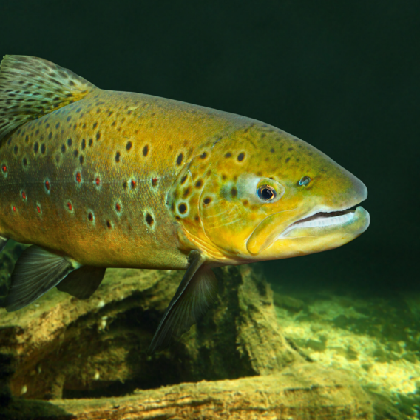
Brown trout
Native

Slide 26
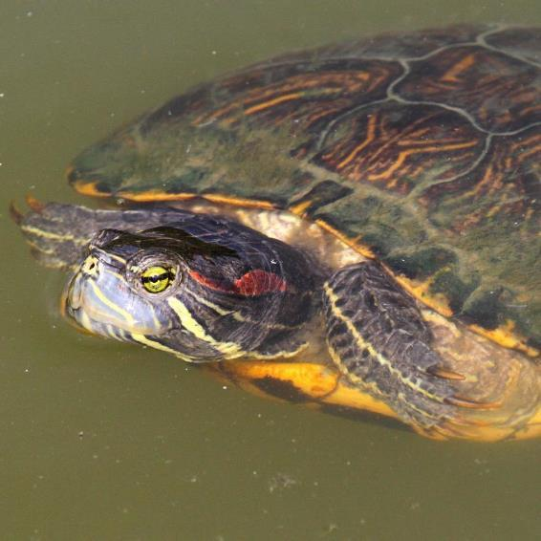
Red eared terrapin
NoN - Native
Released widely into the countryside in the late 1980’s.
Following the popularity of the Teenage Mutant Ninja Turtles TV series many were bought as pets but later released, unwanted, into the wild.

Slide 27
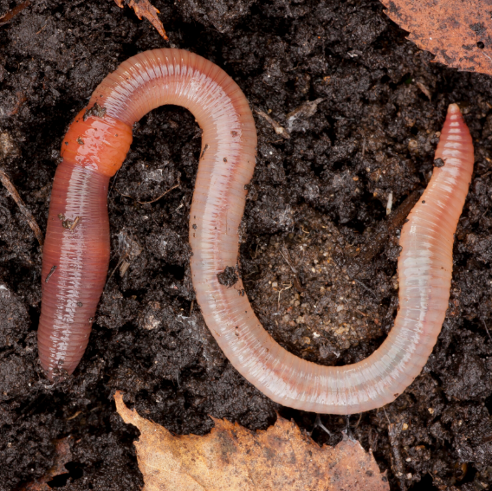
Earthworm
Native

Slide 28
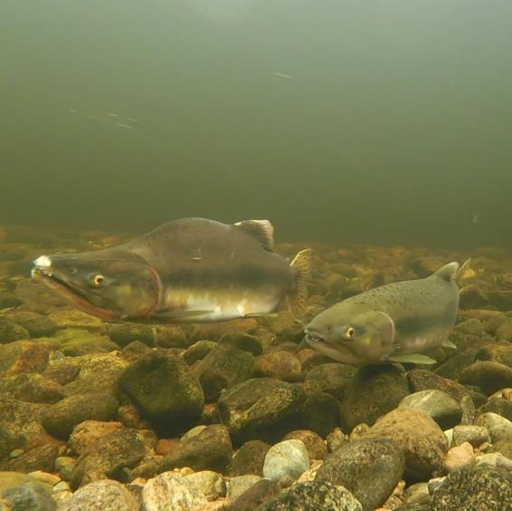
Pink salmon
NoN - Native
First recorded in our rivers in 1960 and has been recorded periodically since then. Appeared in larger numbers in Scottish rivers in 2017.
It is also known as the Humpback salmon.

Slide 29
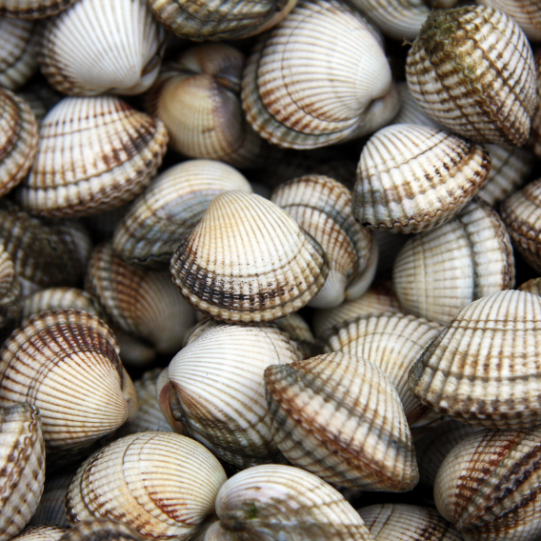
Carpet shell
Native

Slide 30
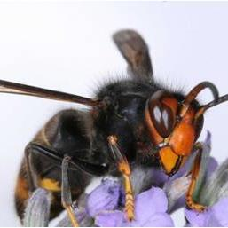
Asian hornet
NoN - Native
One to watch out for! It has been spotted in Great Britain only recently - since 2016.
It is present in France and has flown across the English Channel to reach us!

Slide 31
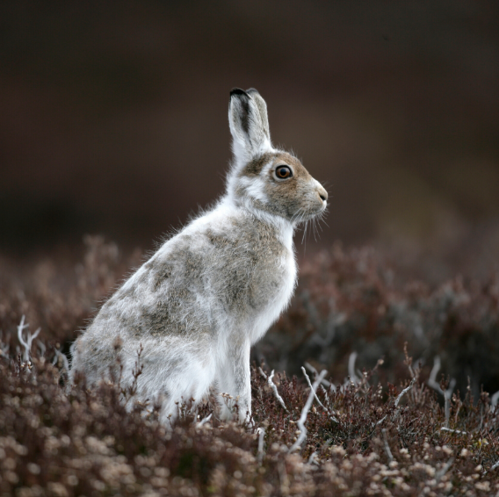
Mountain hare
Native

Slide 32
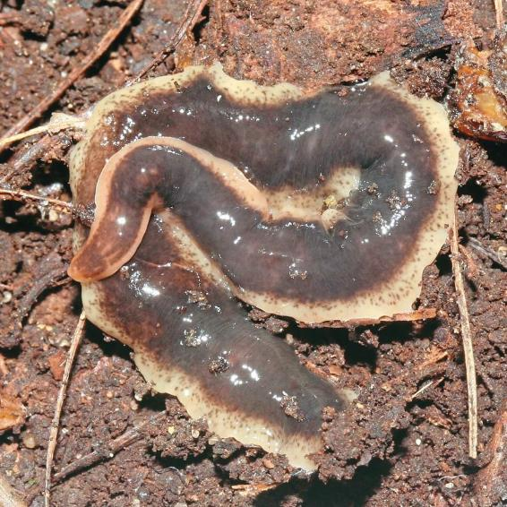
New Zealand flatworm
NoN - Native
Introduced accidently from New Zealand in 1950’s in soil.
Kills our native earthworms!

Slide 33
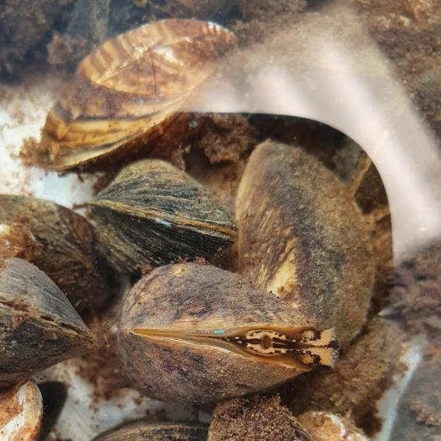
Zebra mussel
NoN - Native
The first record of this mollusc in our seas was in 1825.
Brownish in colour with distinct zig-zag stripes.

Slide 34
How did you do?
1-10 correct
Trainee Alien Detective
A bit more learning required!
11-20 correct
Alien Detective
Great job, but room for improvement.
21-30 correct
Top Alien Detective
Well done! You’ll be able to recognise those aliens no problem.
31-32 correct
Expert Alien Detective
Superb! You’ll make an outstanding Alien Detective.

