Slide 1

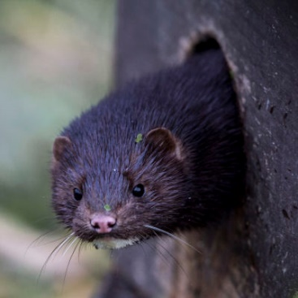



American Mink
The Good, The Bad and The Water Vole

Slide 2
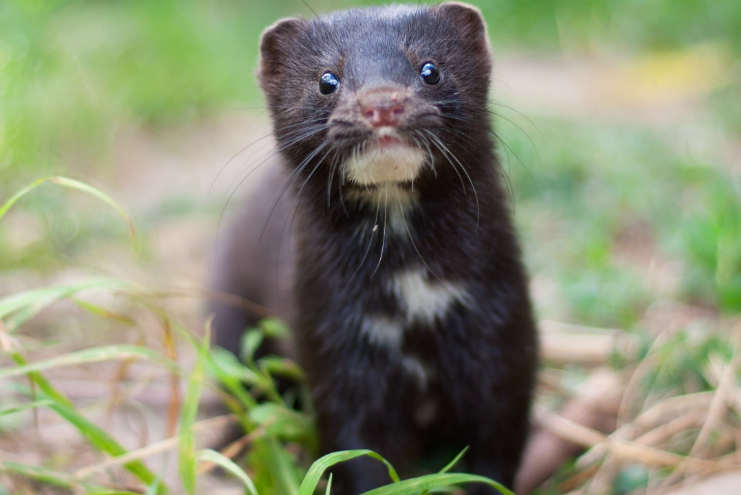
What is an American mink?

Slide 3
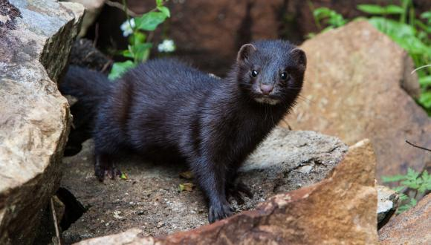
What is an American mink?
Biology & Ecology
Member of the family Mustelid
Semi Aquatic
Carnivore
Body Length 30 – 45cm long, Tail about half of that again
Hunts mostly by sight but can hear ultrasonic rodents ‘squeaks’
VERY smelly – scent glands
Territorial – territories 1-3km female, Males up to 6km
Average of 4 kits per litter – Max recorded 16!!!

Slide 4
Mink video

Slide 5
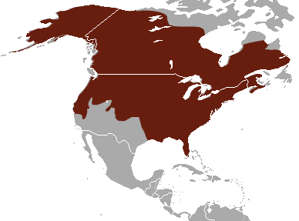
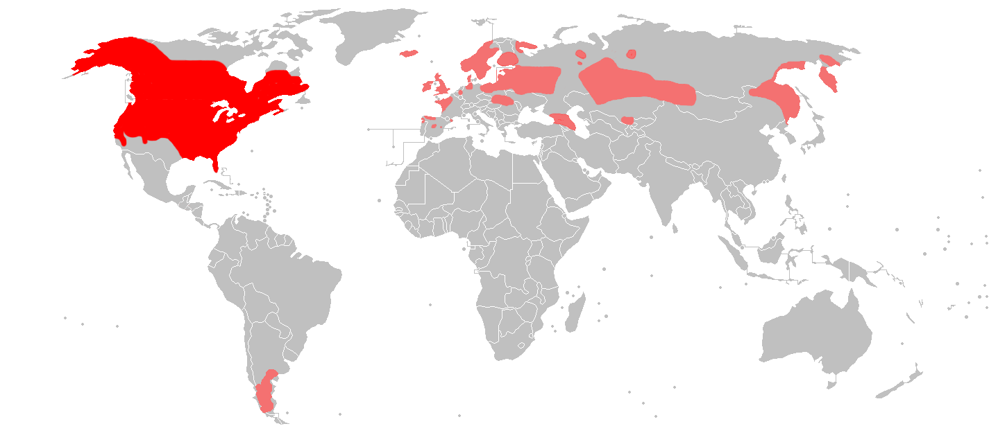
Where are mink from?
North America
New global population

Slide 6
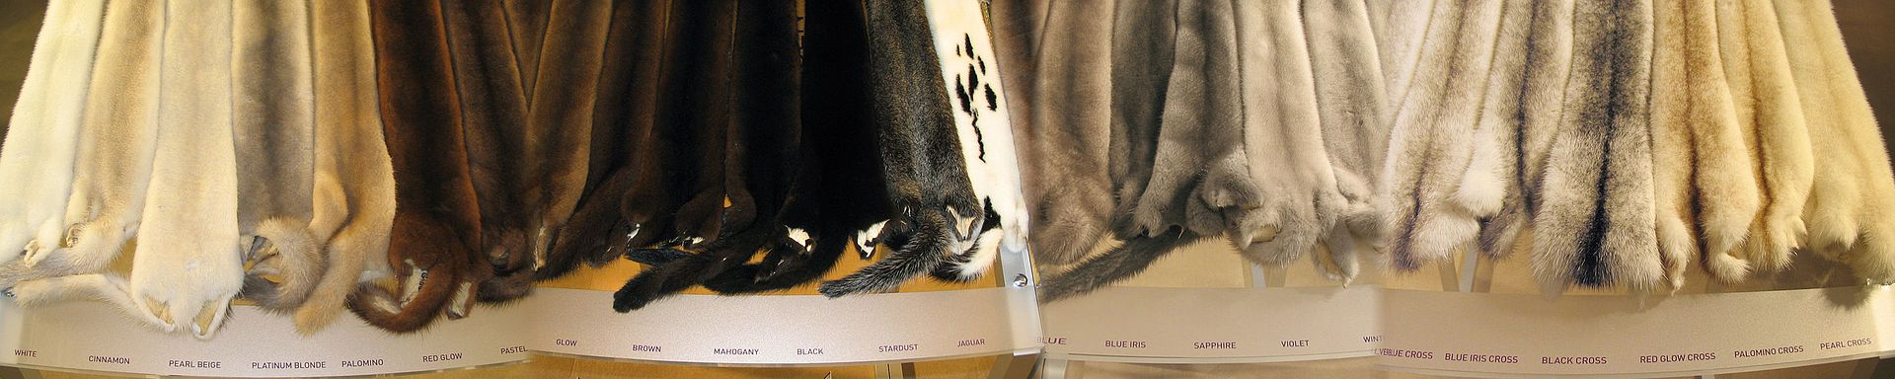
Introduction into the UK
First brought in to the UK in 1929 for fur farming, first Scottish farm 1938
Escapes and releases occurred immediately
By 1950s a self supporting feral population present in Devon
1960s there were feral populations all over the UK
Fur farming banned in 2000… but this was far too late

Slide 7
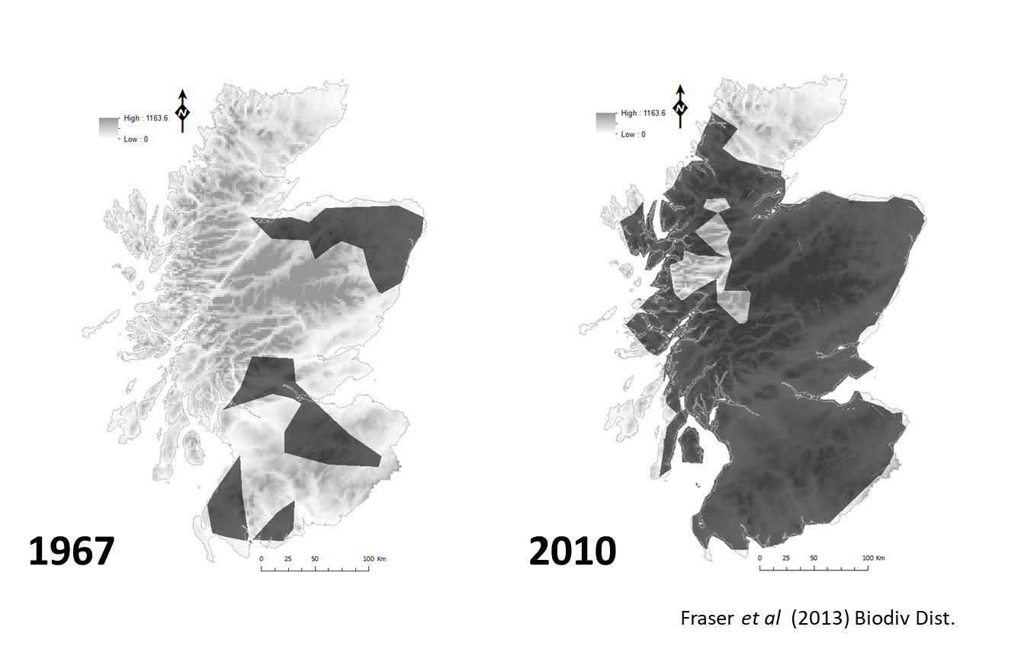
Spread in to the UK
1995 estimate of wild population: >100,000 across UK,
>50,000 in Scotland

Slide 8
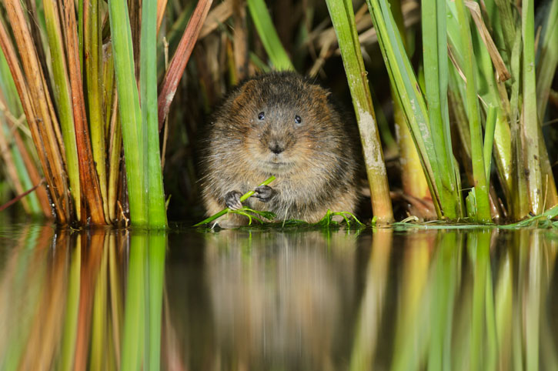
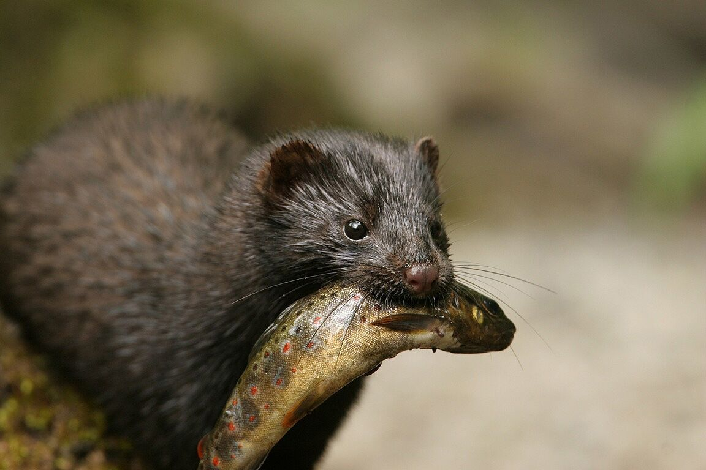
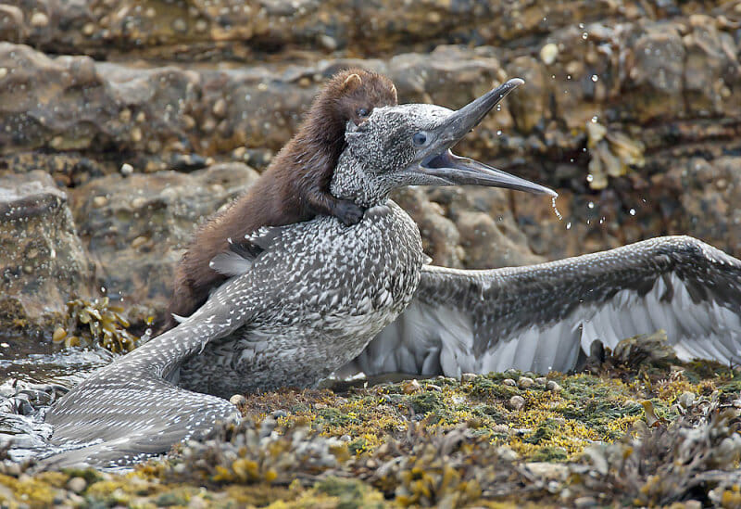
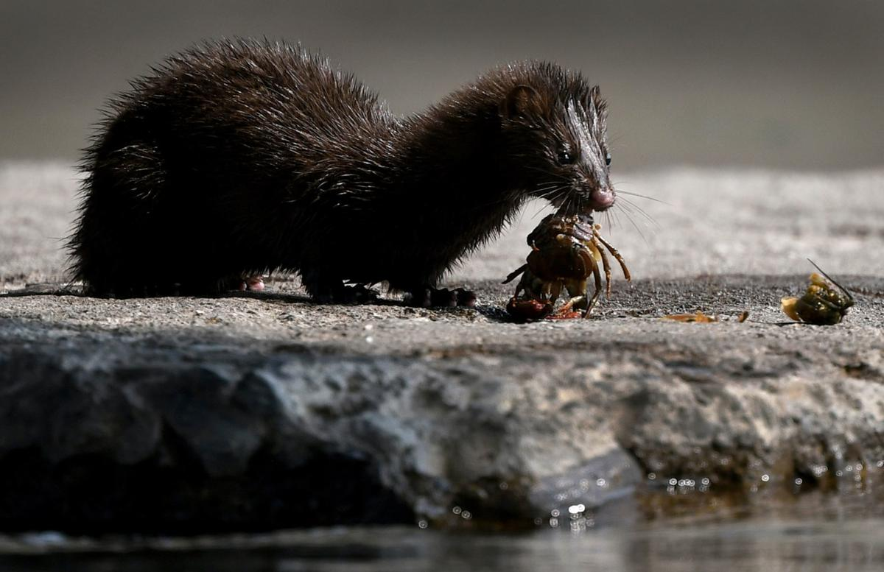
Why are we worried?

Slide 9
Water vole video

Slide 10
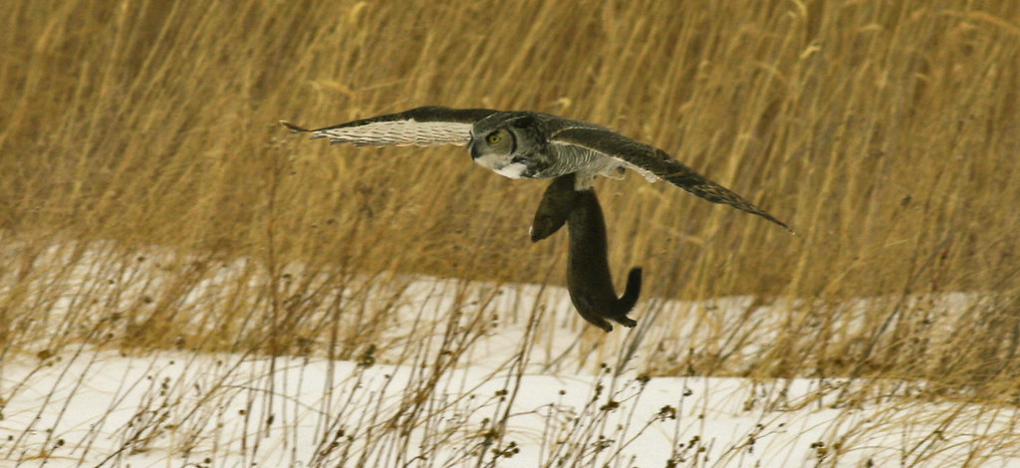
How have mink spread so quickly?
No Natural predators
Predators in natural range: Coyotes, Wolves, Bears, Great Horned Owls and Bobcats
Otters do exclude to an extent
Increased reproduction when density is low
Amazing dispersers – average mink dispersal is approx. 20km but can be up to 80km

Slide 11
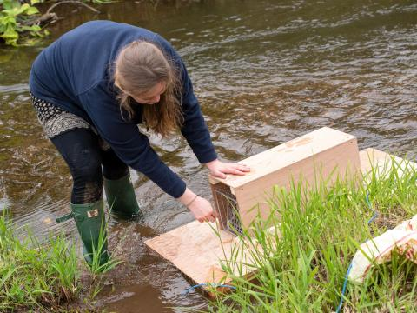
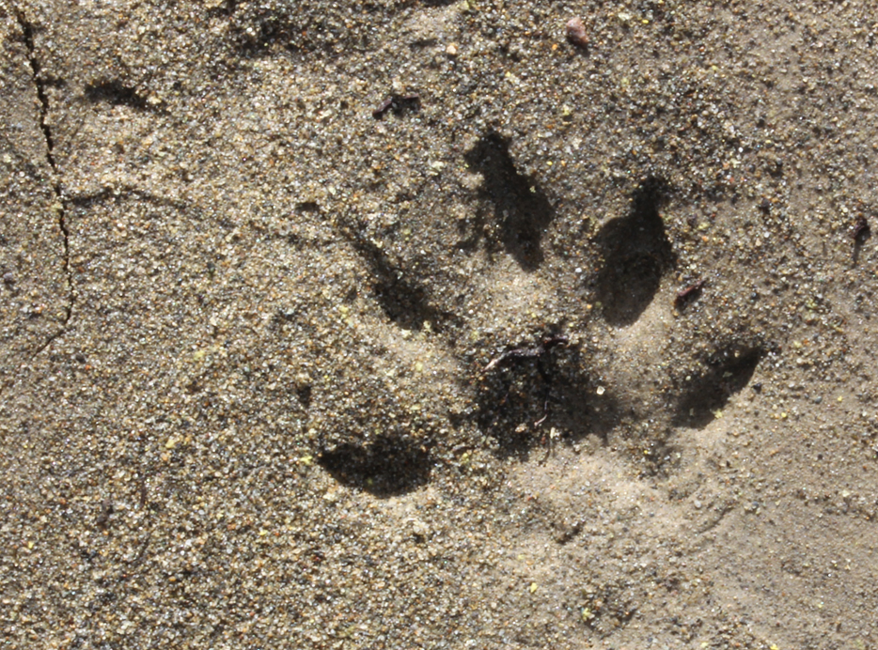
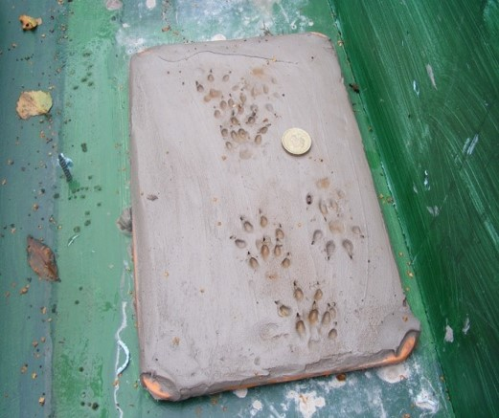
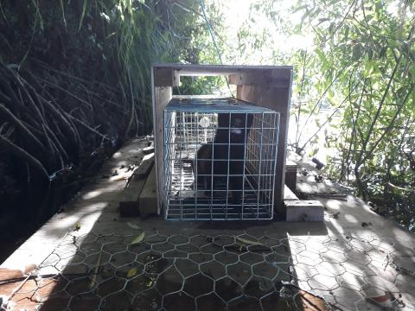
What can we do to stop the spread?
Lets find out!

Slide 12
Questions
?

